Slide 1
Electronic Devices and Circuits Lab 01
Lab overview

Slide 2
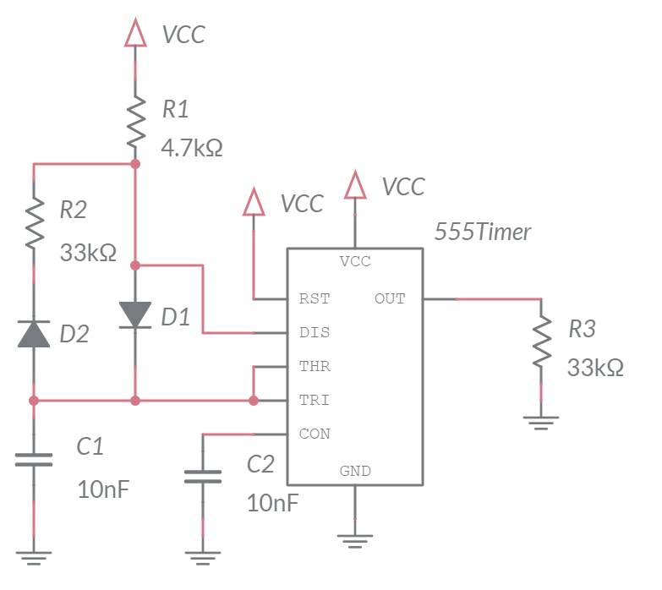
555-Timer circuit
Produces oscillating waveform
Low duty cycle
Will be used later in curve tracer

Slide 3
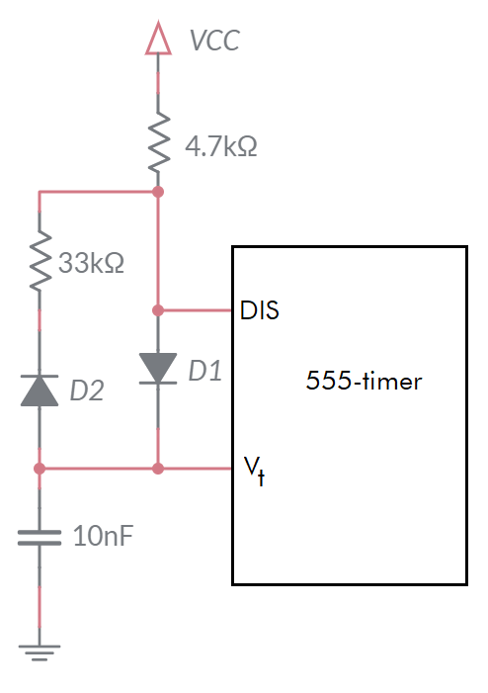
555-Timer analysis
Charging Mode
4.7k and 10nF in series
Determine time to charge cap from 3V to 6V
Discharging Mode
33k and 10nF in series
Determine time to discharge cap from 6V to 3V

Slide 4
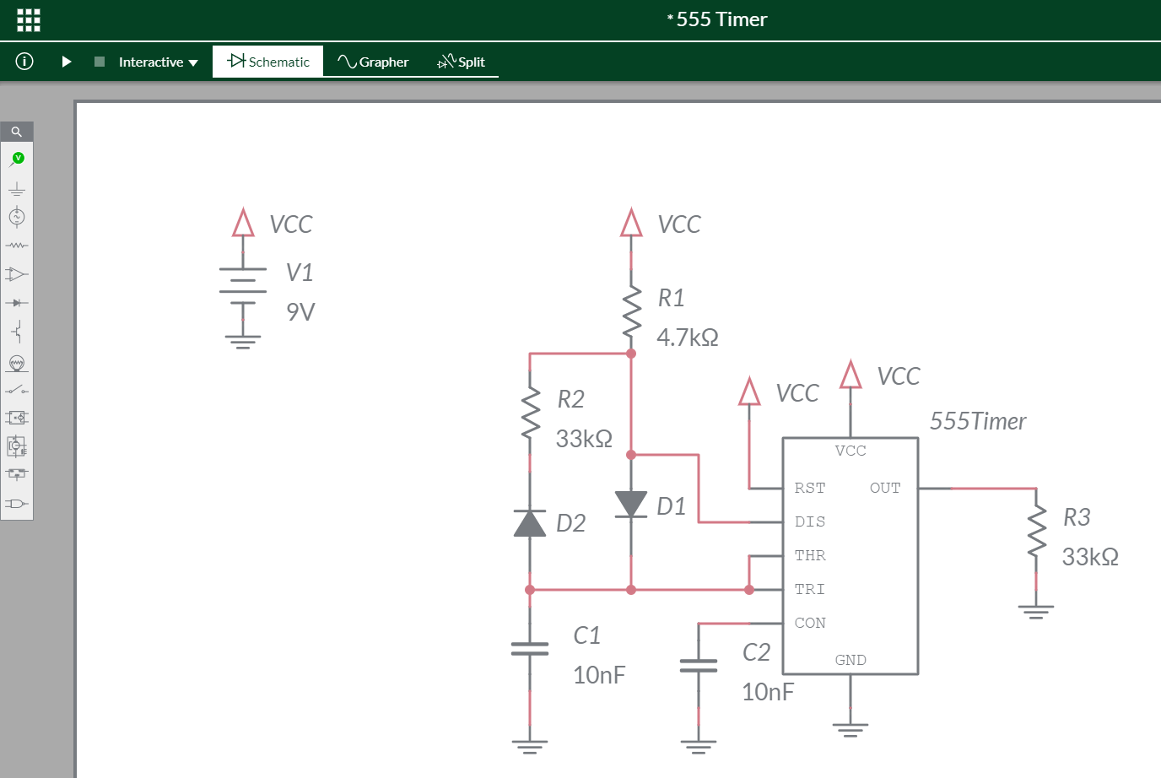
Multisim Live – Schematic
Create Multisim Live account
Use interface to
Select parts
Position parts
Connect parts
Assign component values

Slide 5
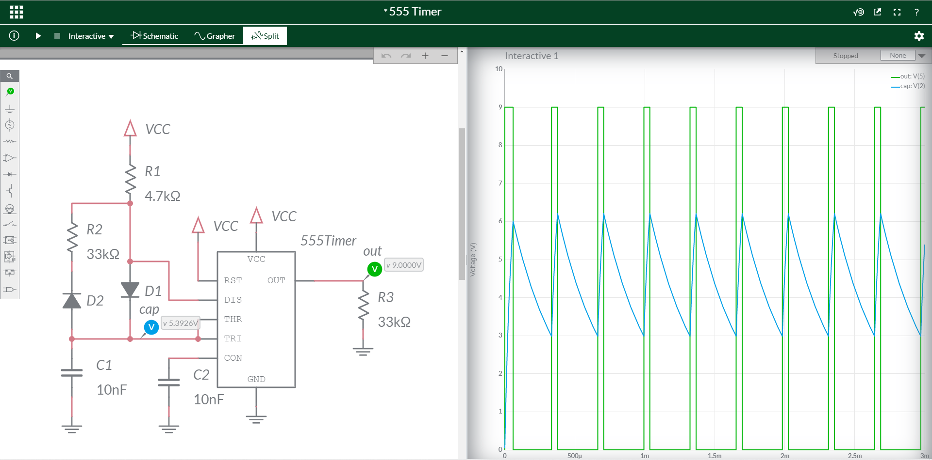
Multisim Live - Simulation
Add probes
Set simulation time

Slide 6
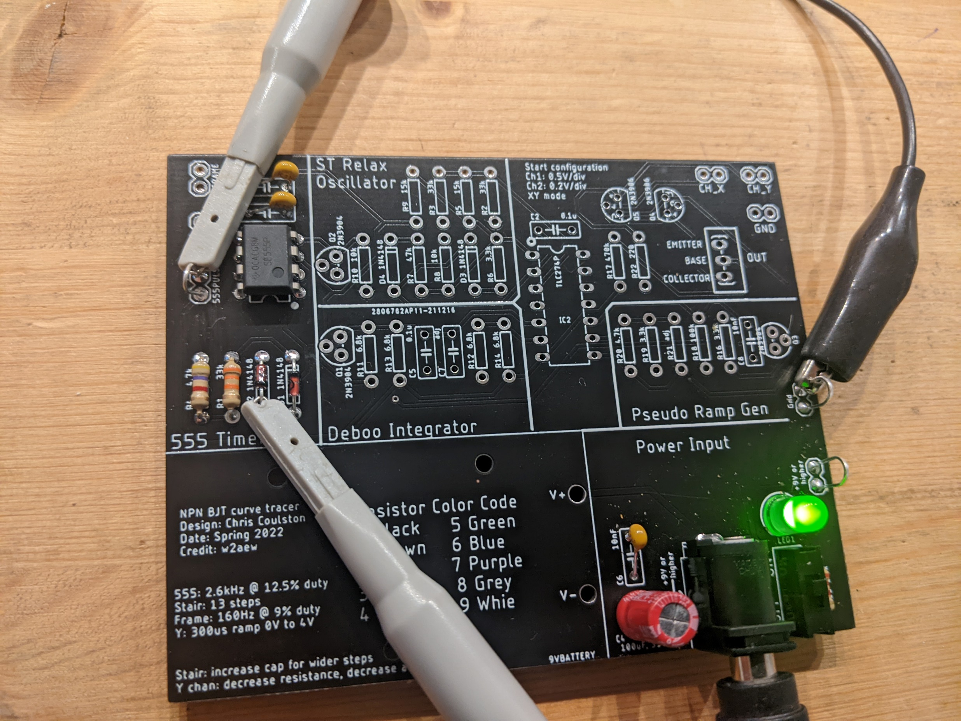
555-TIMER Construction
Get parts bag
Only assemble 555 and PWR
Use eye protection
Solder in Brown 331
Only apply power using the
connections in the Power Input area
Test TRI and OUT pins of 555

Slide 7
Turn in
Answer listed questions
Save solutions as PDF
Due before start of class next week
Every student builds their own board
Everyone brings their board to class

